Slide 1
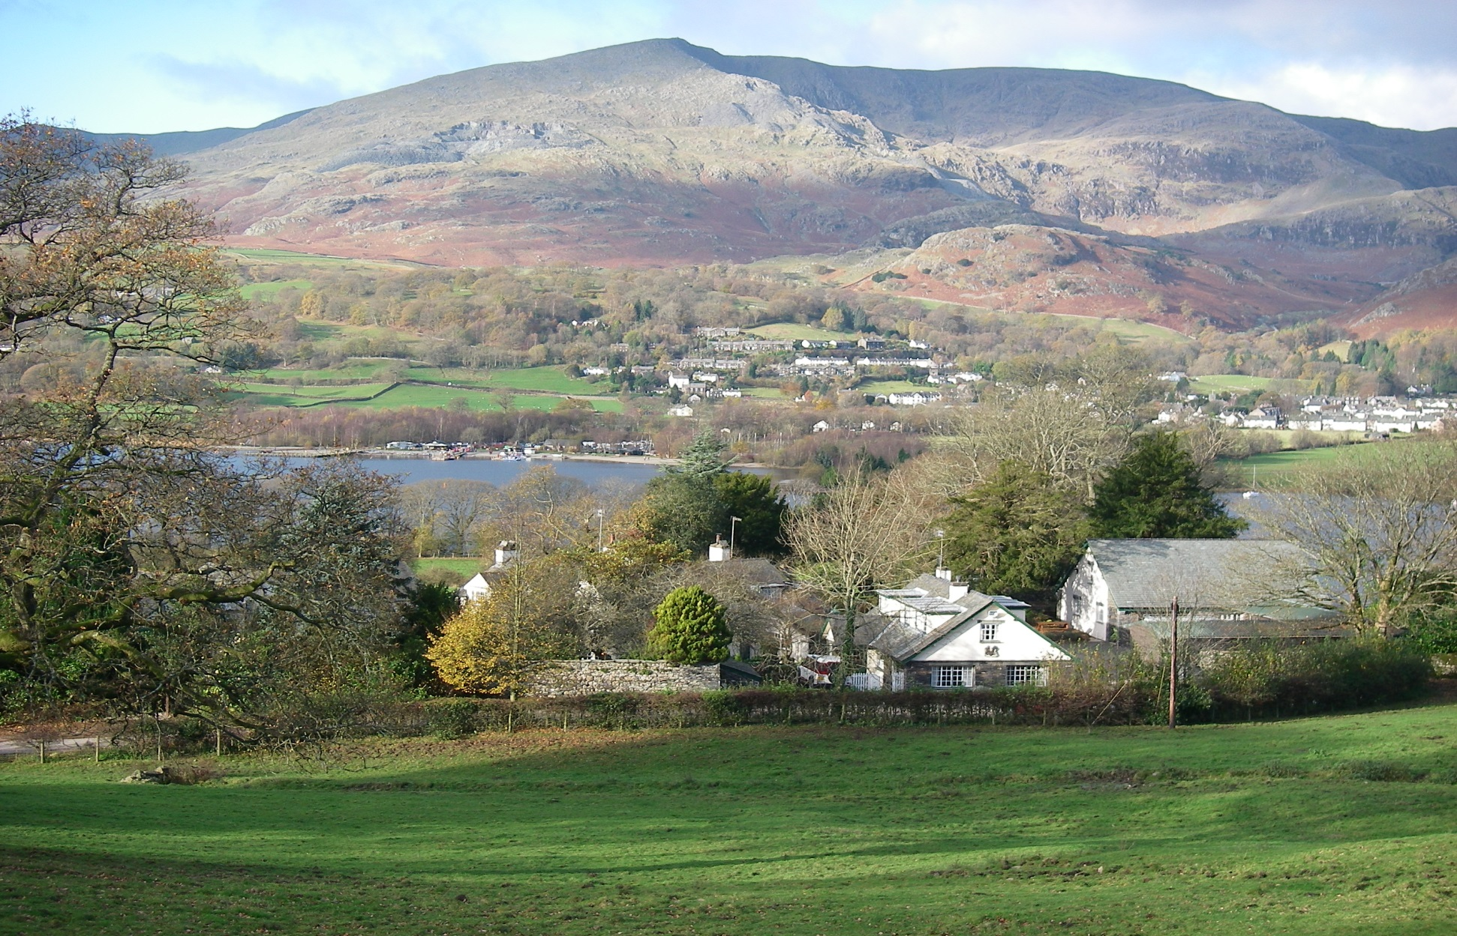
Learning through the Outdoors
Geoff Cooper, Institute for Outdoor Learning, U.K.

Slide 2
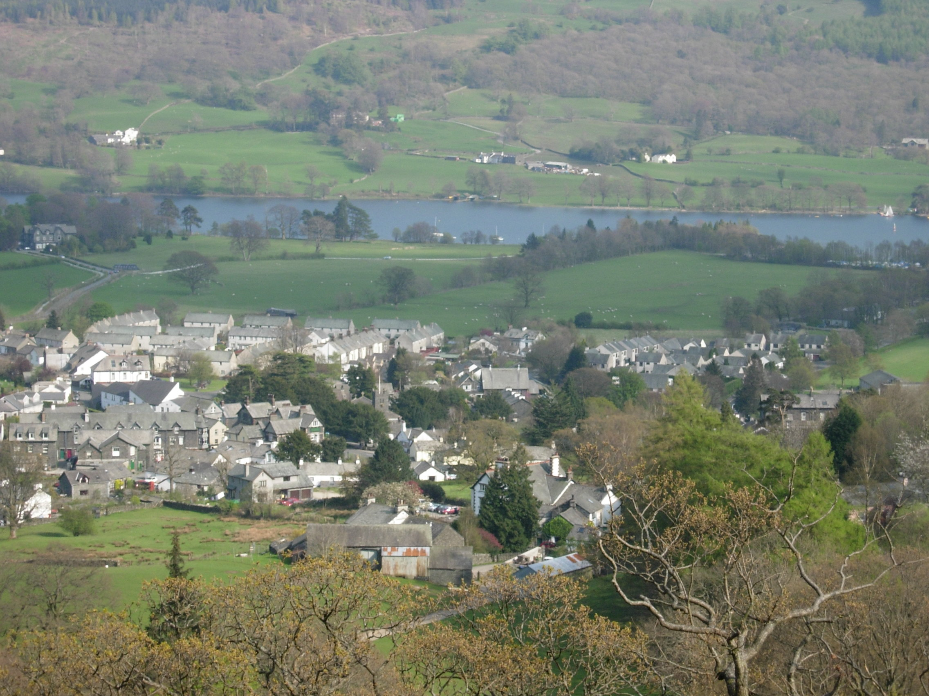
Coniston, Lake District.

Slide 3
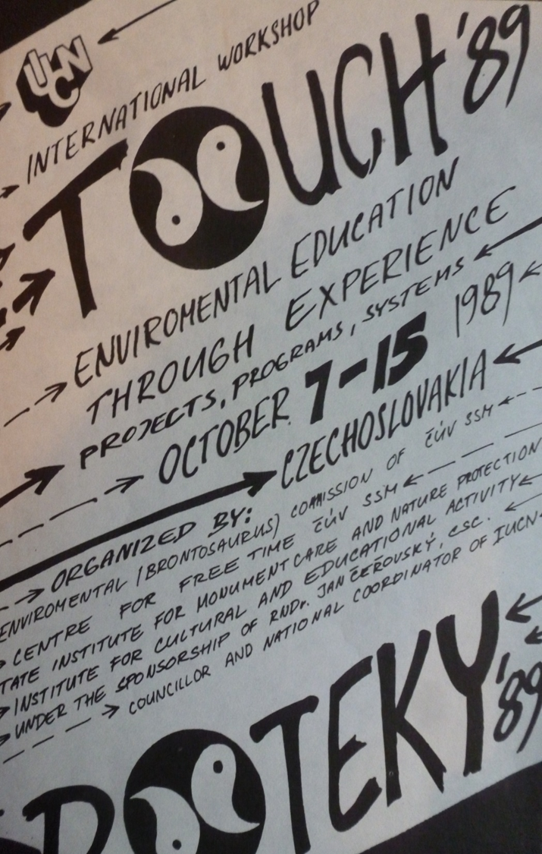
Touch network
First meeting in Sec in Czechoslovakia in 1989.
Organised by Brontosaurus movement.
Hands-on environmental education
Led to many links across Europe including setting up of programmes and centres.

Slide 4

Projects with Vsetin
Two projects 2000-2 based on Local Agenda 21
Led by Iva Koutna and Petr Chytil and John Gittins and Geoff Cooper from UK.
Involved schools, environmental centres, councillors and community leaders.
Teachers produced resources to encourage education for sustainability

Slide 5
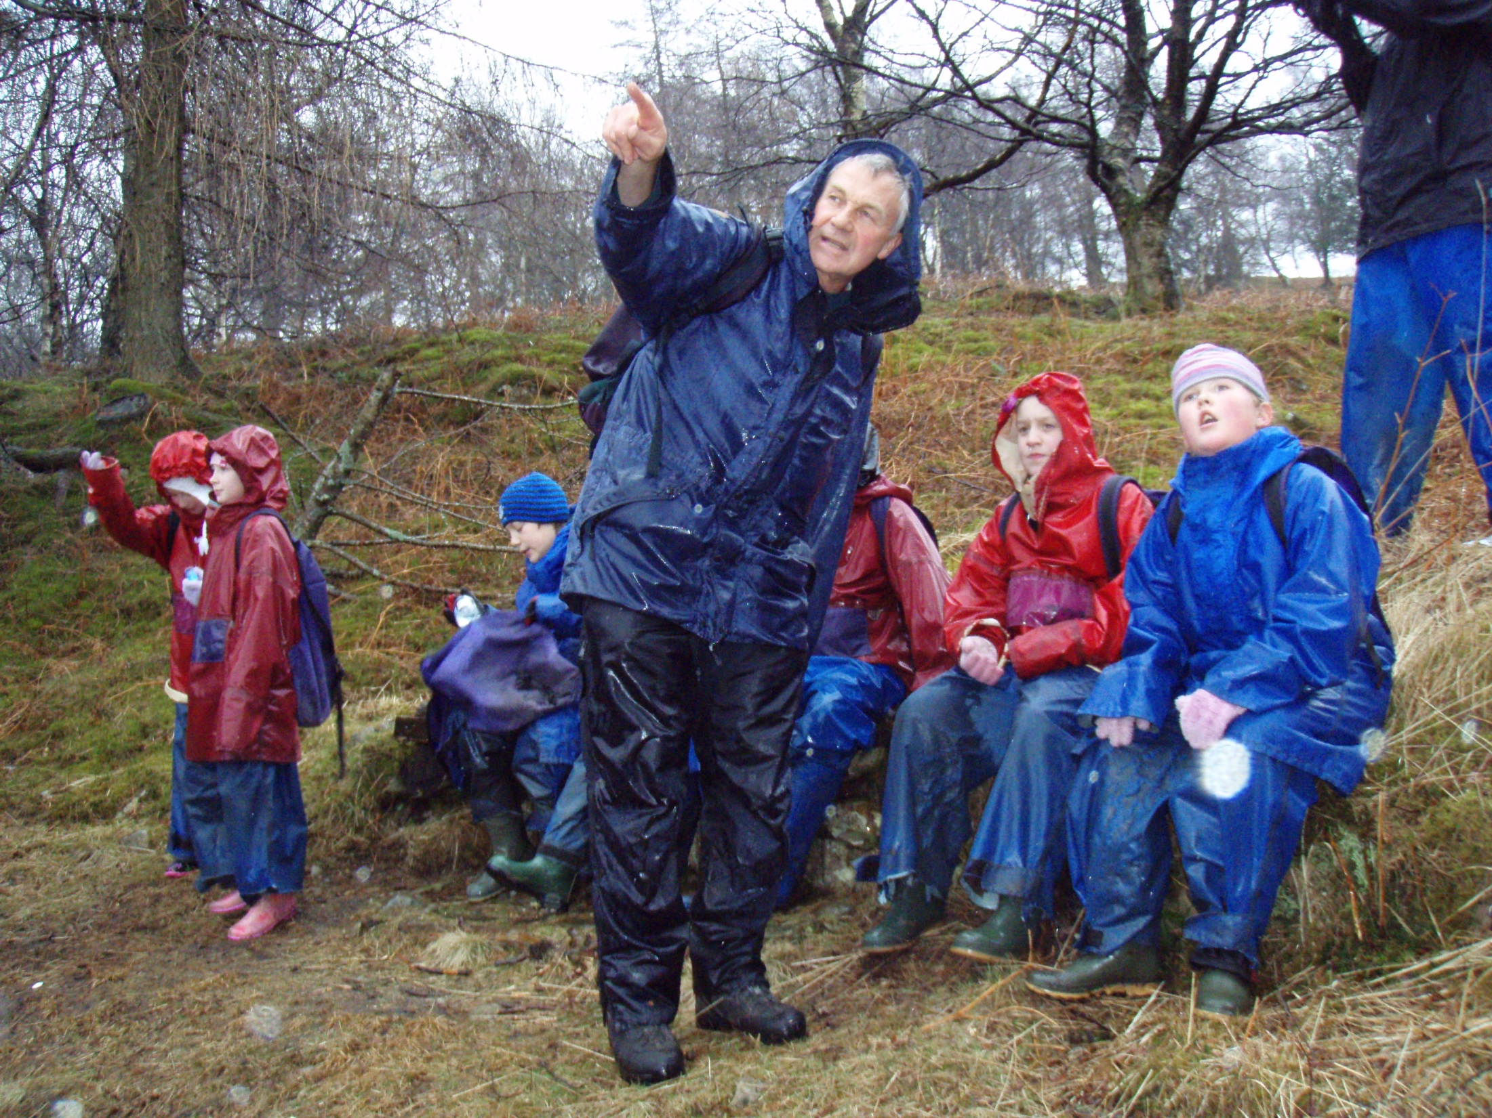

Slide 6
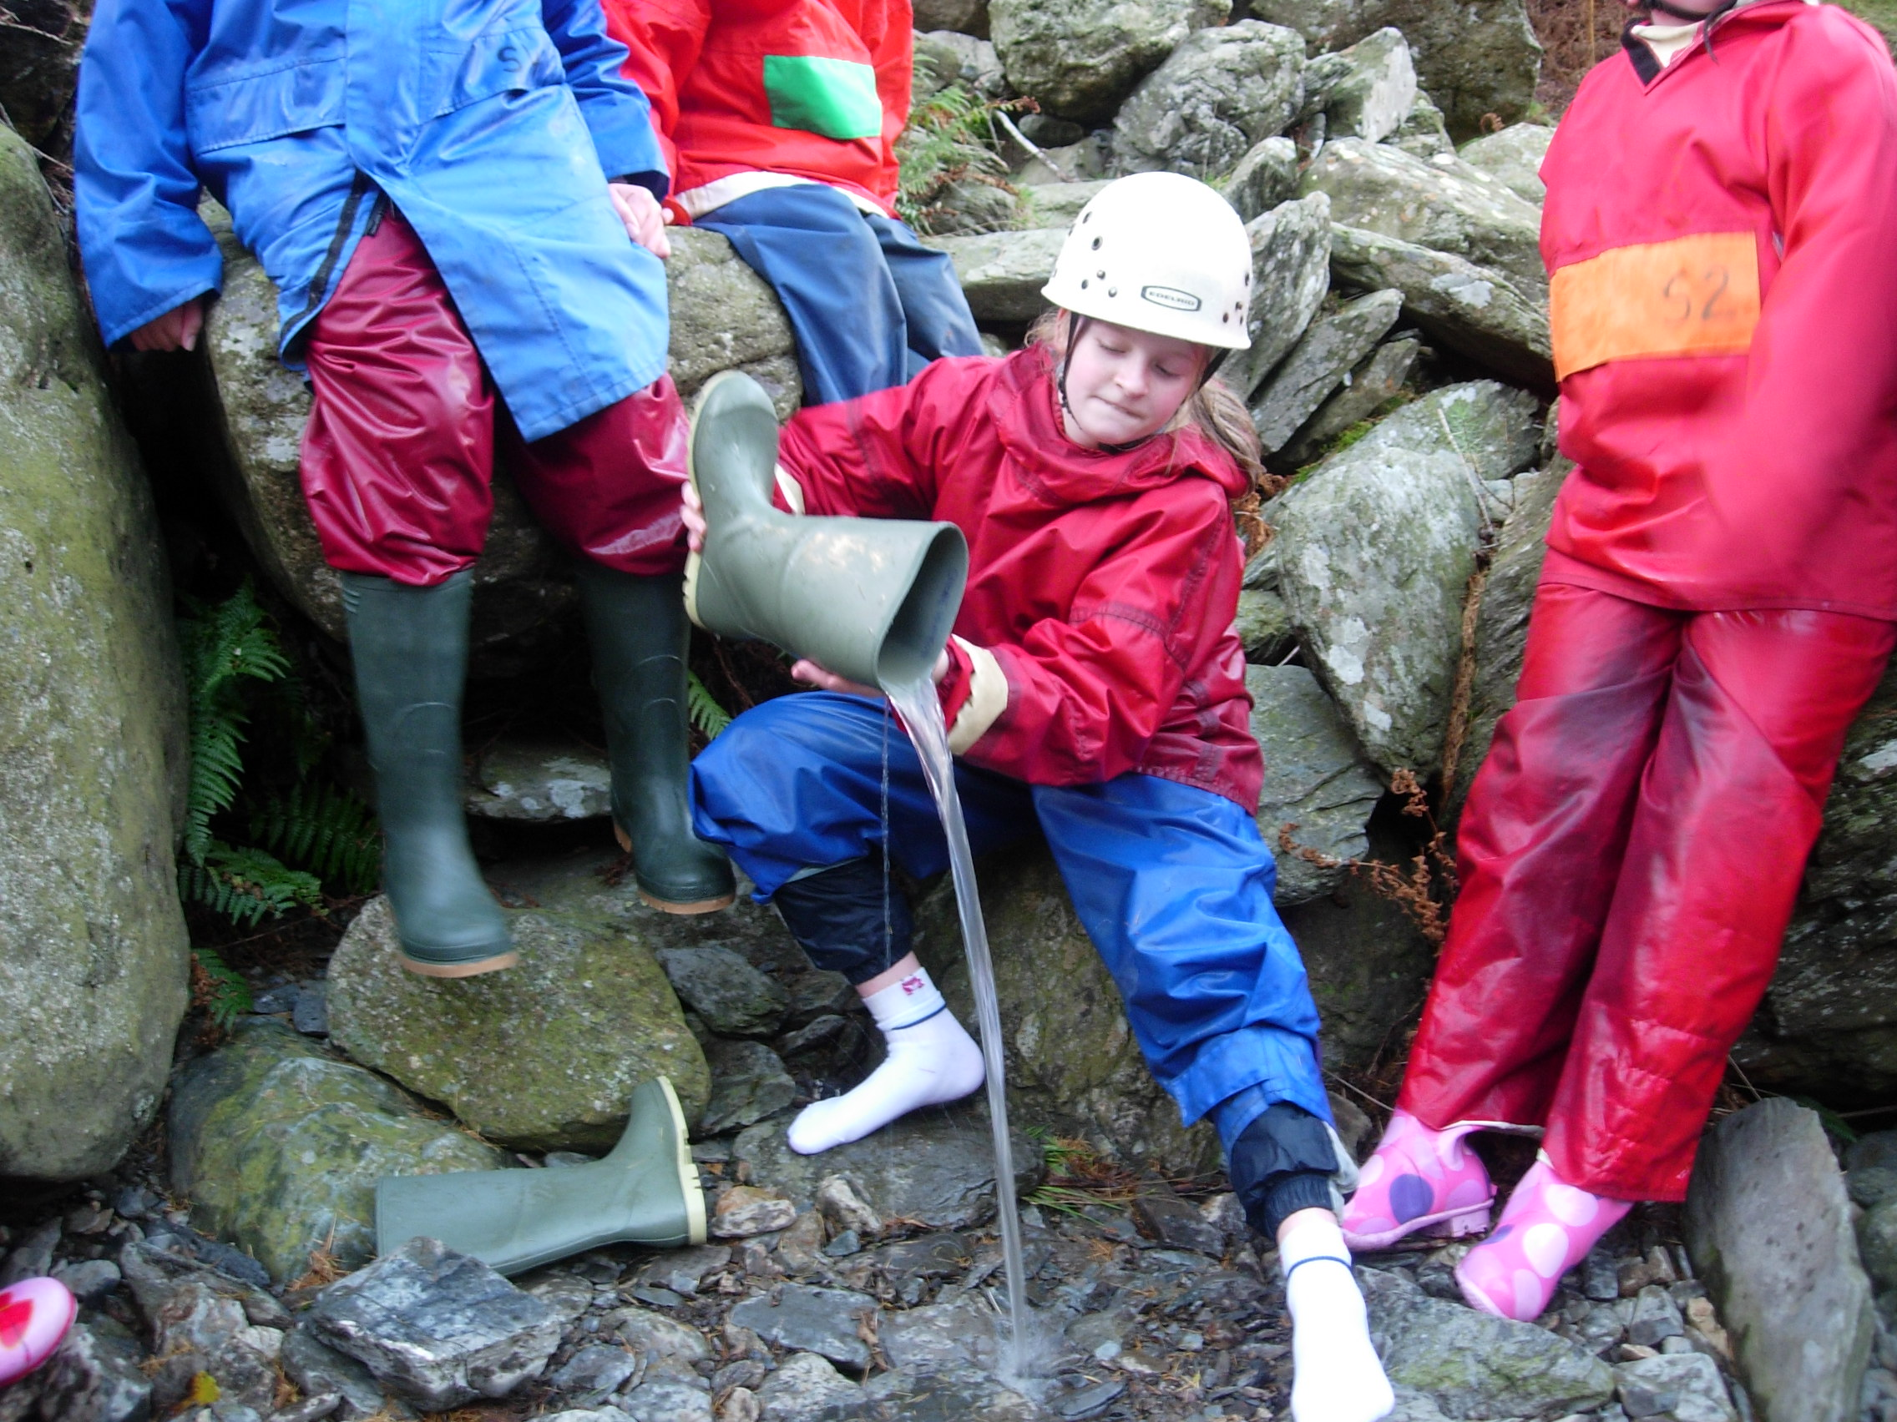

Slide 7
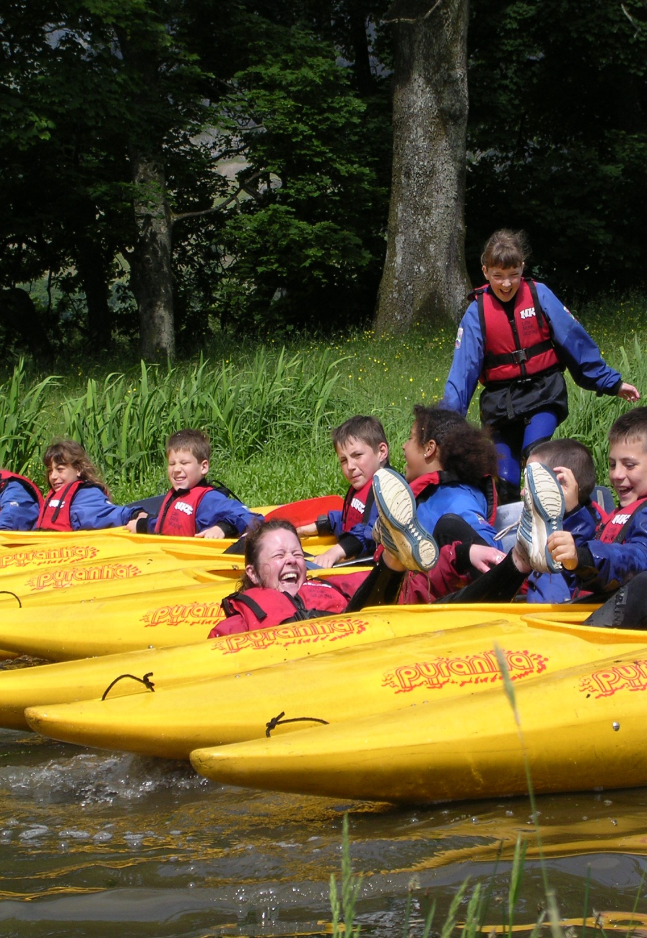
Outdoor Learning
To develop:
personal,
social,
and environmental
awareness and understanding.

Slide 8
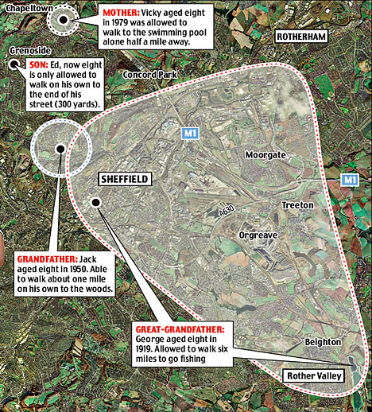
The shrinking world of the child
Disconnections:
Loss of outdoor play
Loss of adventure.
Loss of contact with nature.

Slide 9
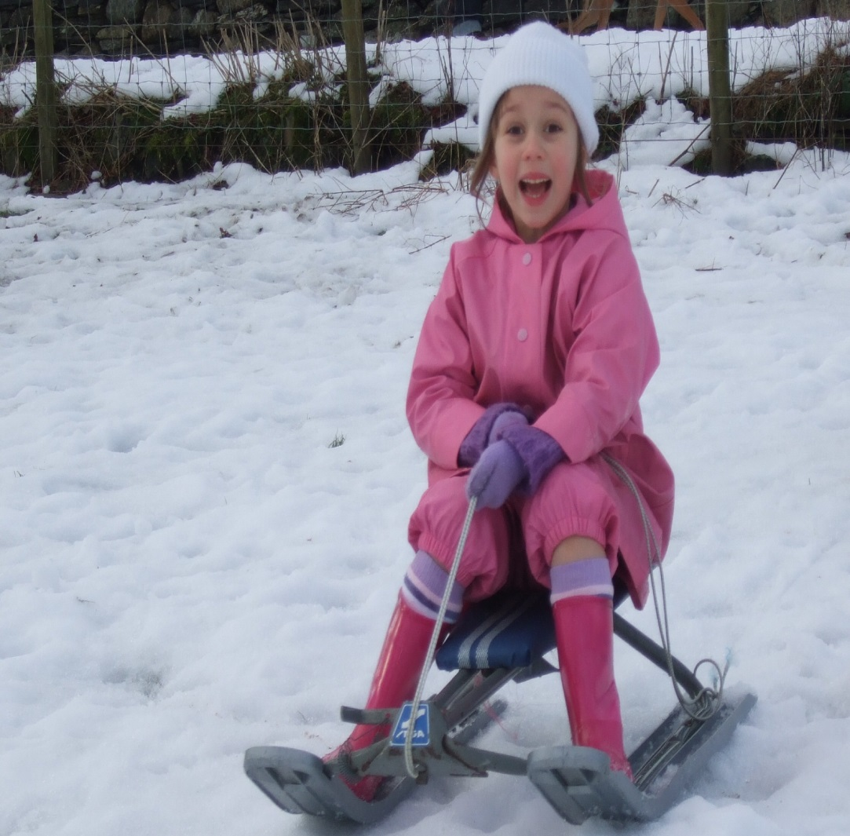
Why are these losses occurring?
A culture based on fear and risk aversion- strangers, traffic.
Less opportunities to take young people out of school.
Indoor lifestyles.
Attraction of screen culture.

Slide 10
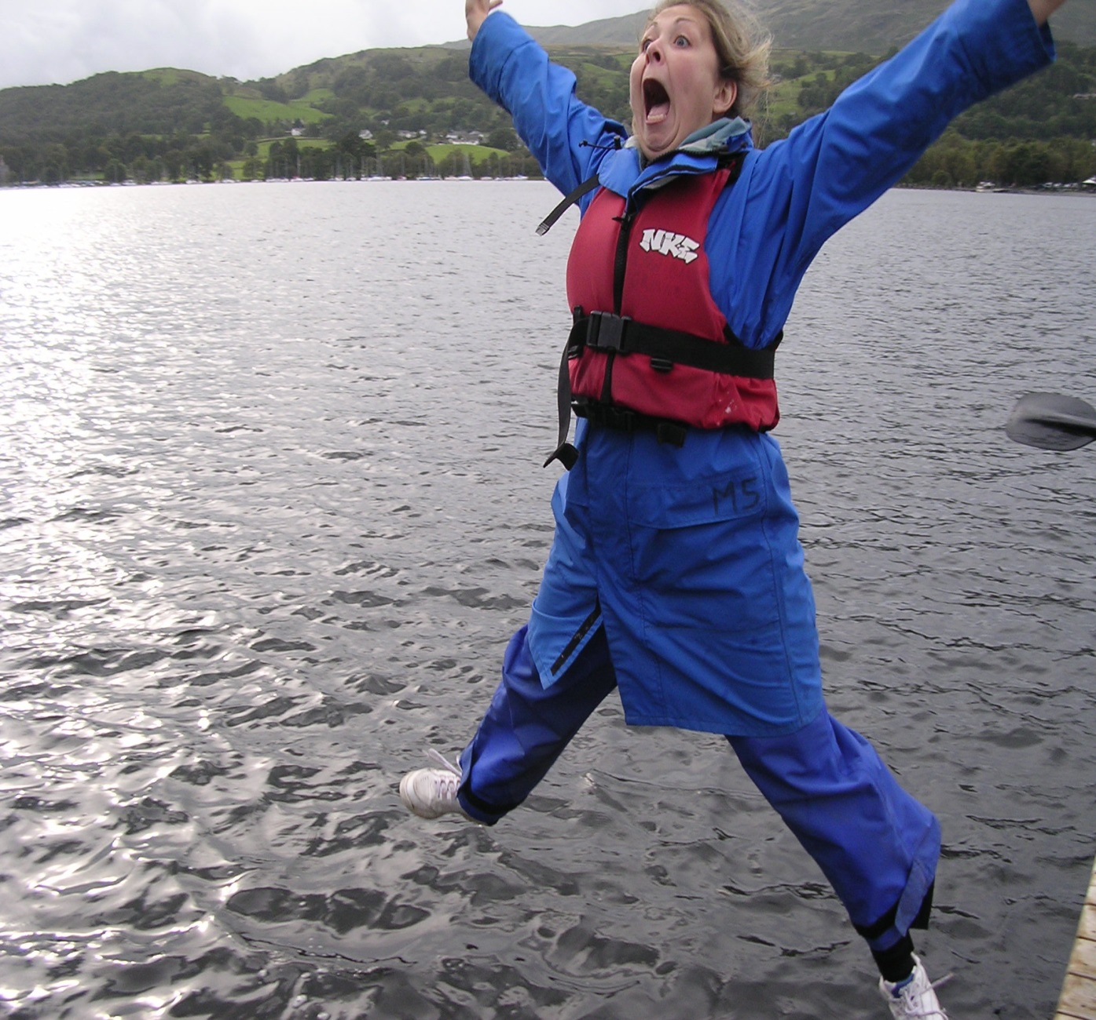
Play- even big kids love to play.
Play- an active form of learning that unites mind, body and spirit.
Freedom to learn through own experience and mistakes.
Free to express creativity and feelings.
Developing physical and social skills.

Slide 11
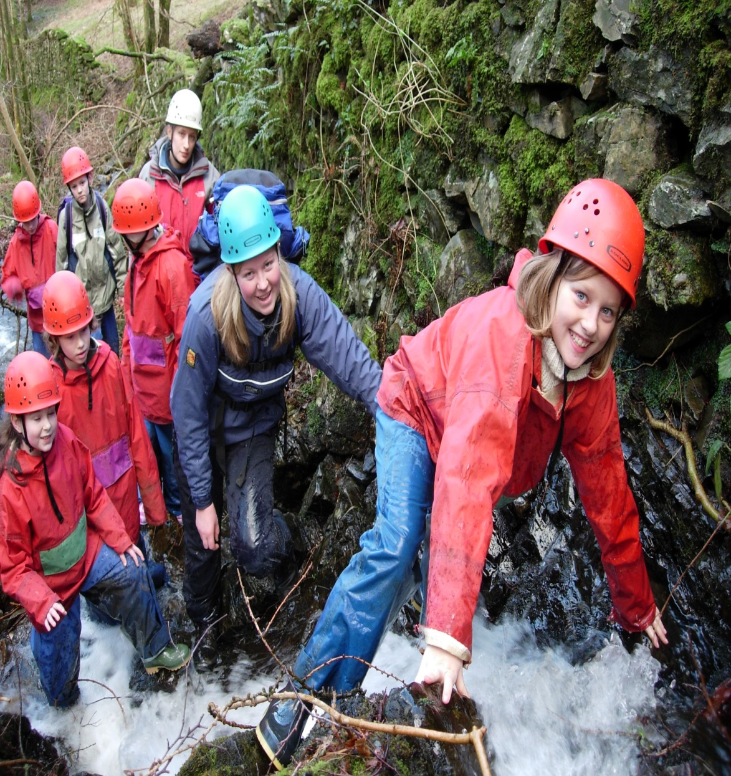
The value of adventure
Joy, enthusiasm, motivation.
Learning to manage risk.
Developing personal awareness & confidence.
Overcoming doubts, fear.
Developing lifelong interests.

Slide 12
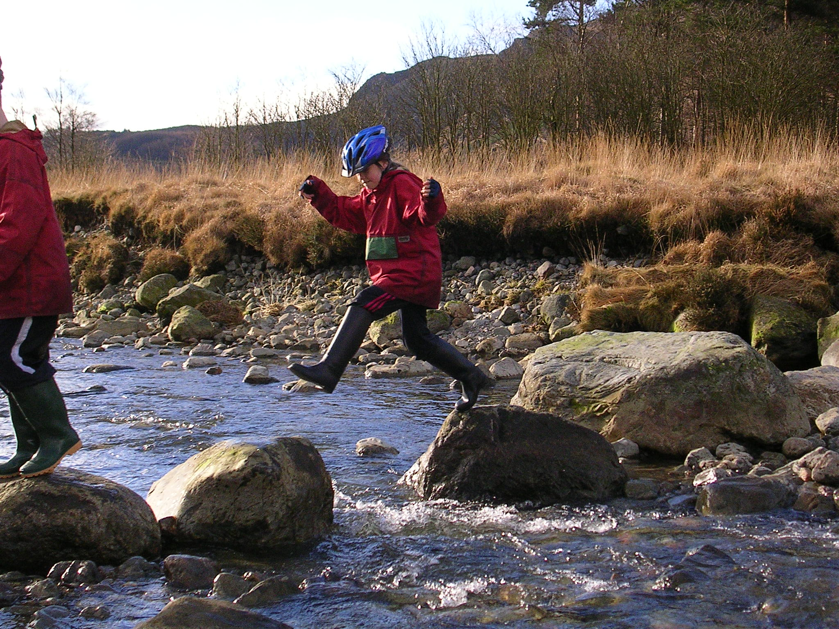
The power of childhood experiences in the outdoors

Slide 13
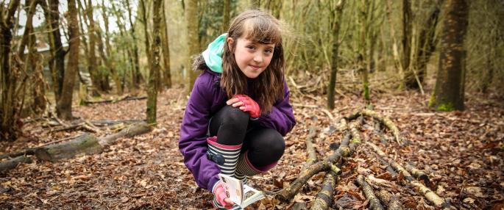
Wildlife Trusts’ research (2015 UK) finds 78% of parents are concerned that children don’t spend enough time interacting with nature and wildlife.

Slide 14
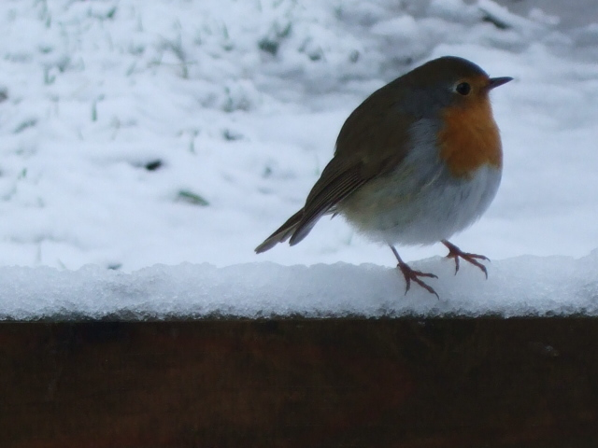
Biophilia hypothesis- Edward O. Wilson (1984).
People have a love of living things that dates back millions of years.
For more than 99% of our history we’ve been hunter-gatherers.
We have a genetic, inner need to commune with nature.
We have an in-built preference for natural landscapes.

Slide 15
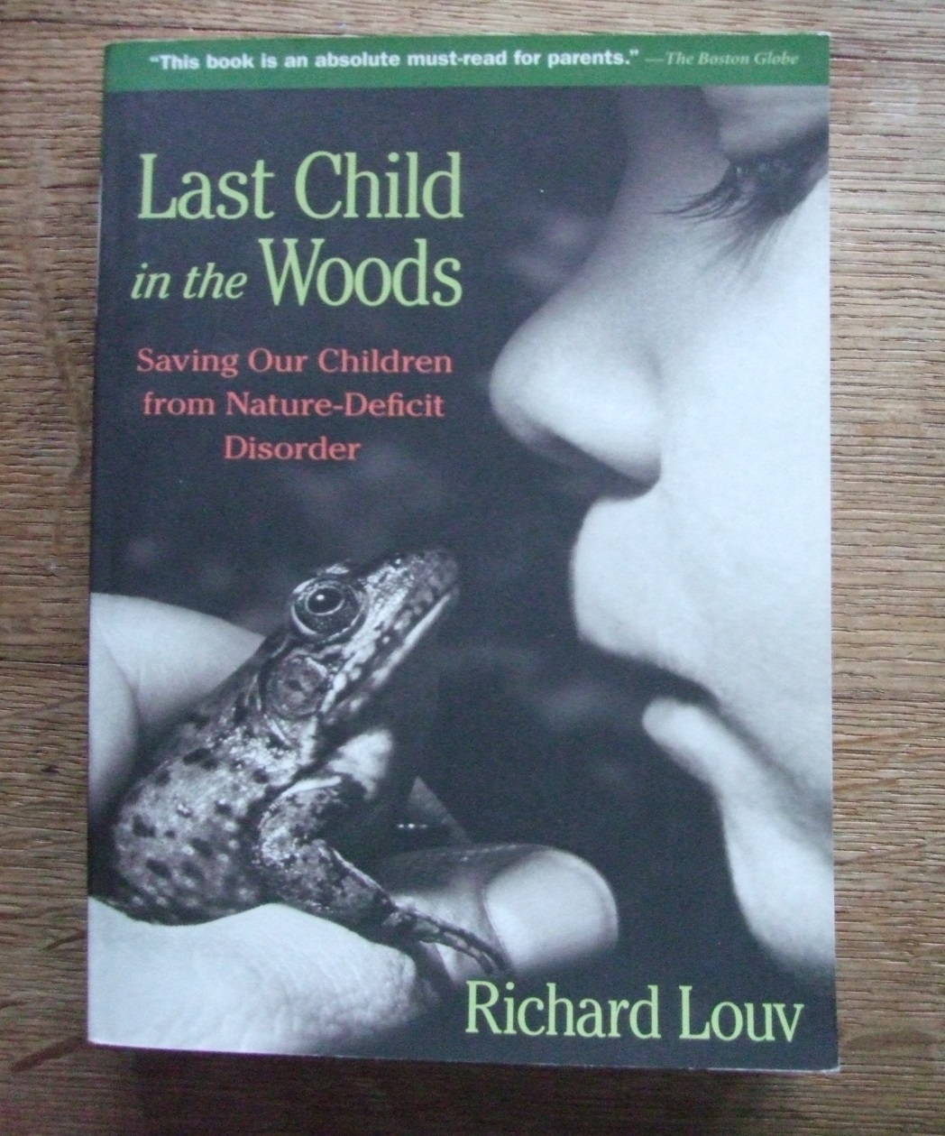
Loss of Contact with Nature- Nature-deficit disorder.
Consumer society discourages contact with nature.
Louv refers to a growing body of research that links our well-being- mental, physical and spiritual health- to a close association with nature.
He gives examples of how the outdoors can be used as a therapy for young people.

Slide 16
Manifesto for Learning Outside the Classroom.
“Every young person
should experience the
world beyond the
classroom as an essential
part of learning and
personal development,
whatever their age,
ability and circumstances”.

Slide 17






Slide 18
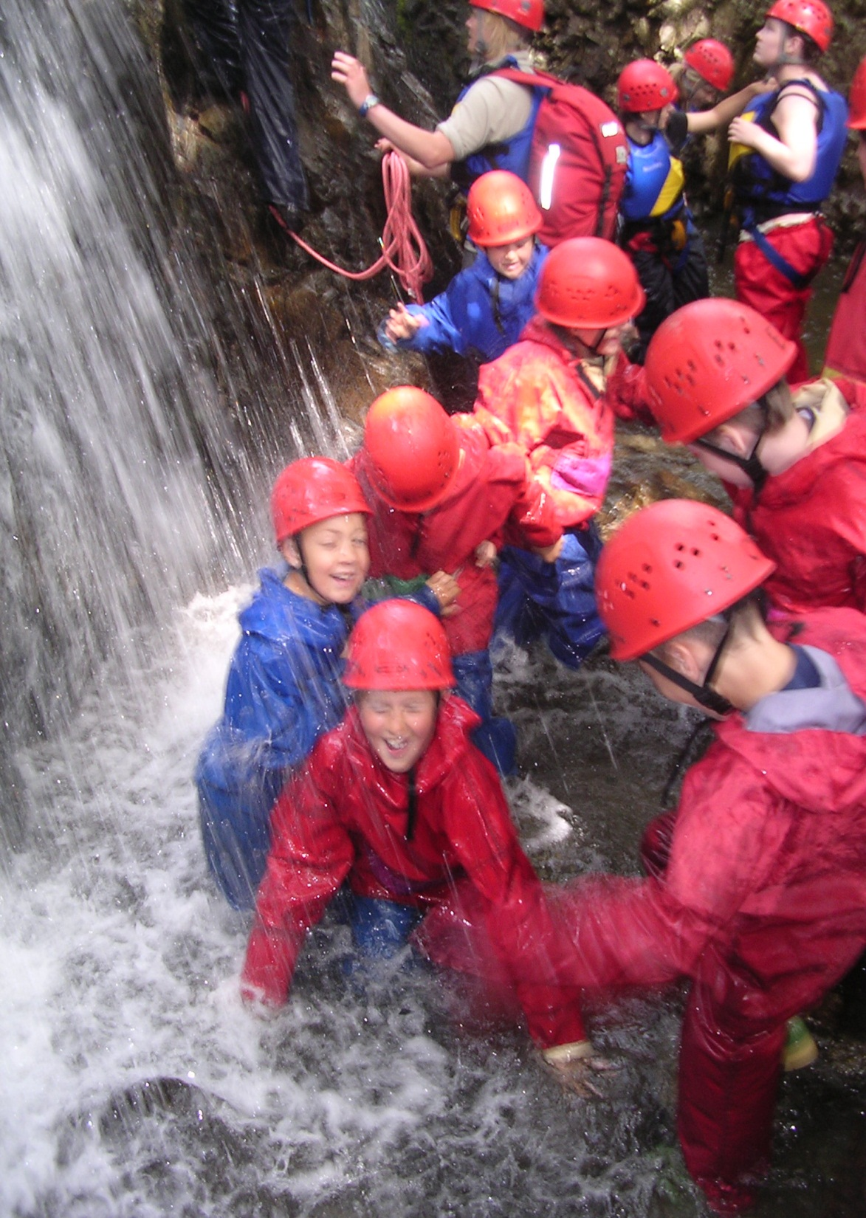
Outdoor learning can encourage:
Personal responsibility.
Co-operation.
Creativity.
Problem solving.
Critical thinking.
Healthy lifestyles.
Sense of place.
Contact with nature.
Reflection and reviewing.

Slide 19
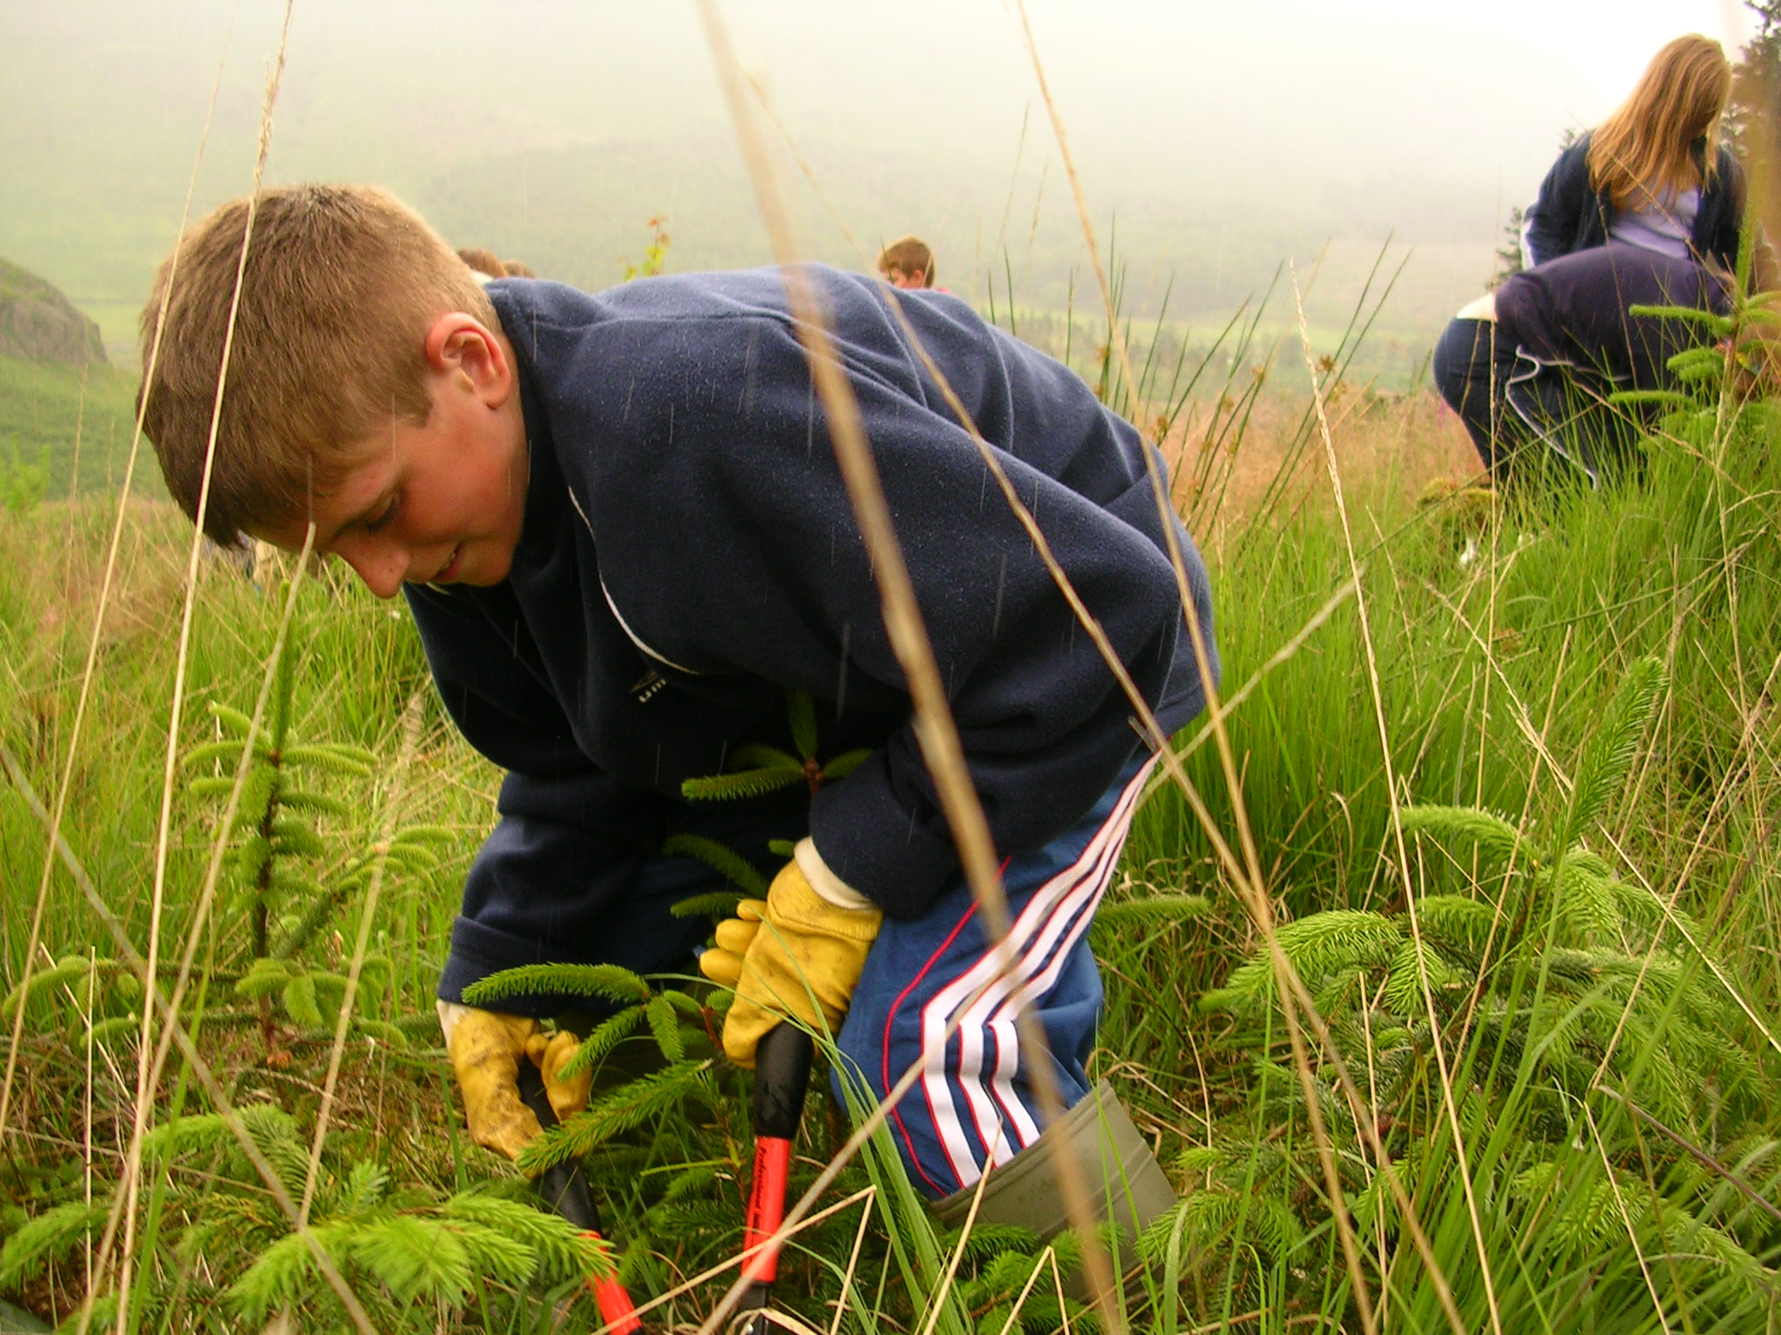
Taking personal responsibility.

Slide 20
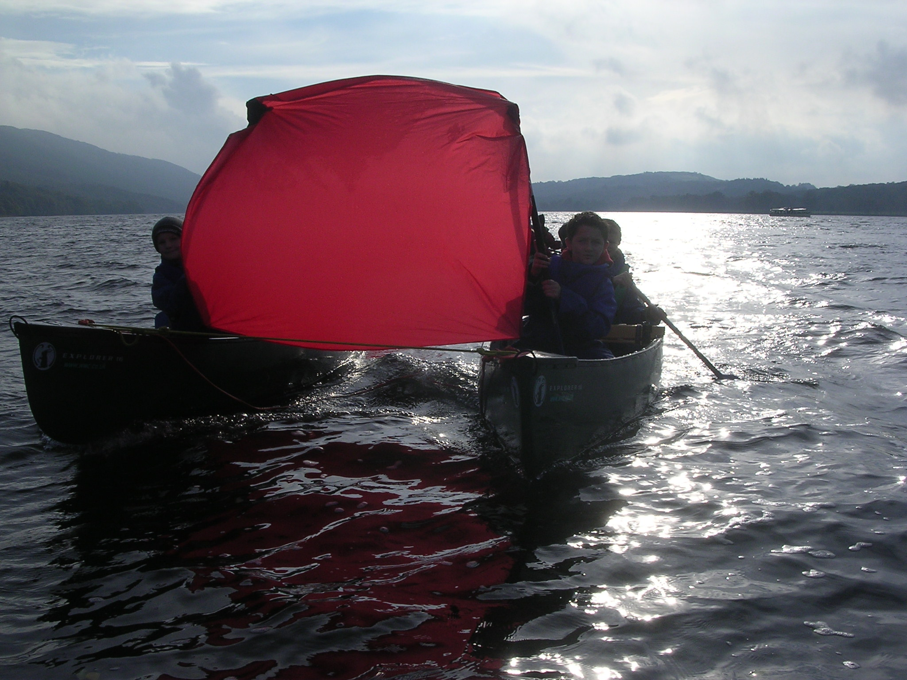
Co-operation.

Slide 21
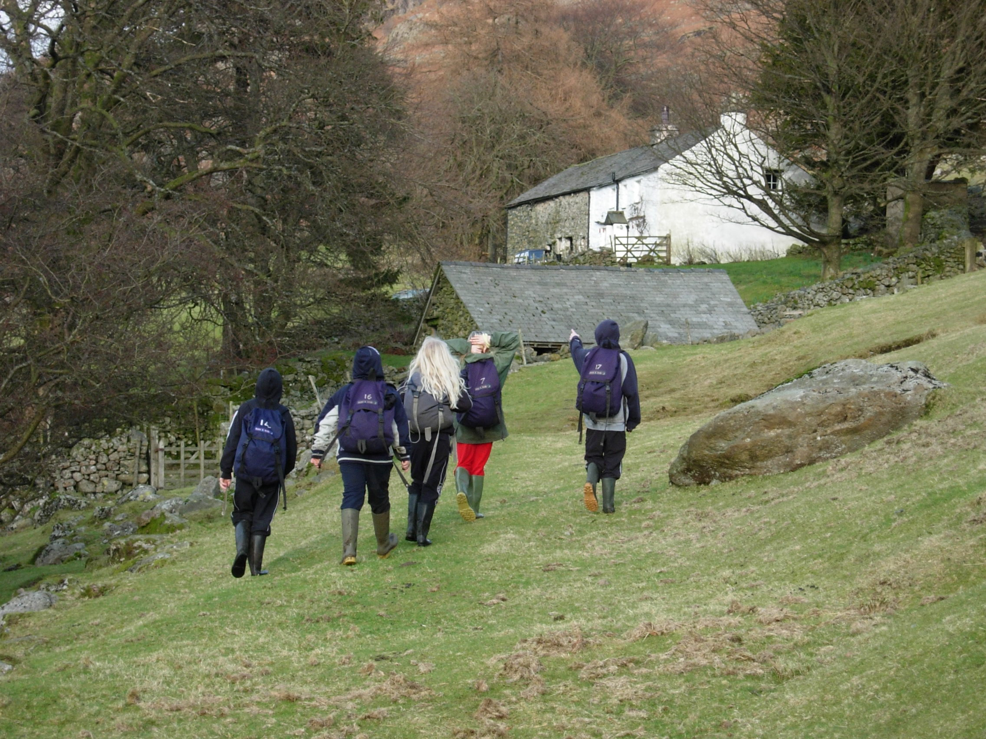

Slide 22
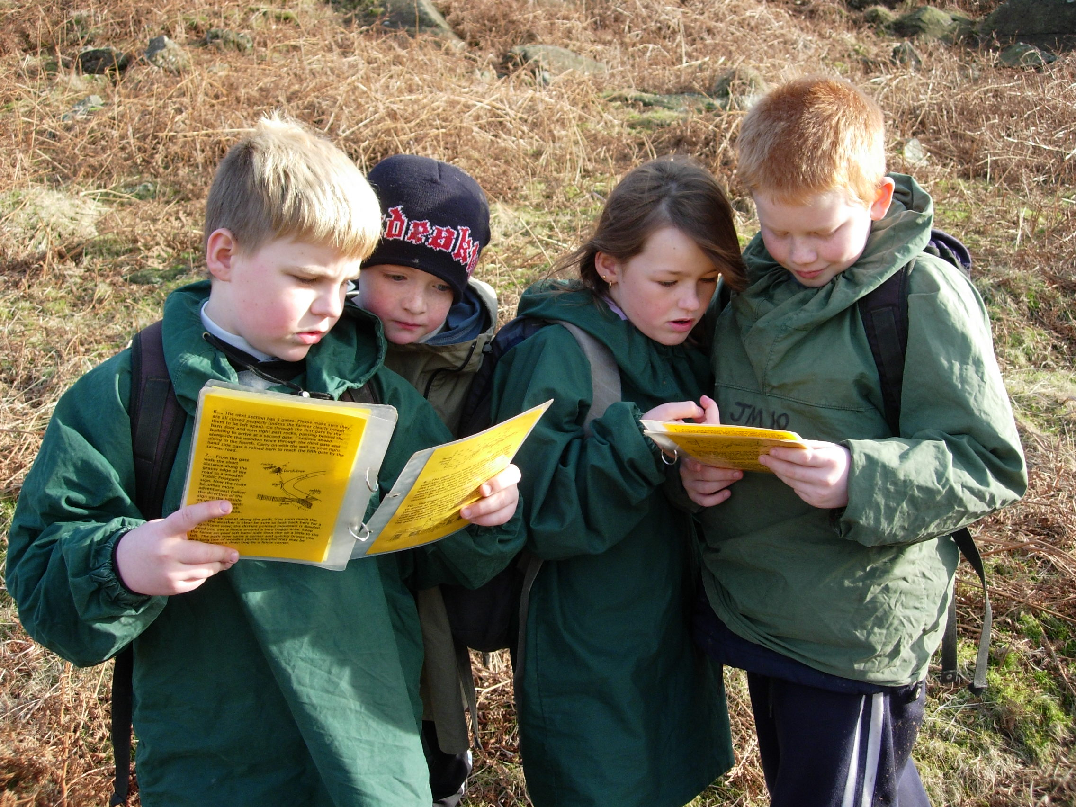
What skills are being developed?

Slide 23
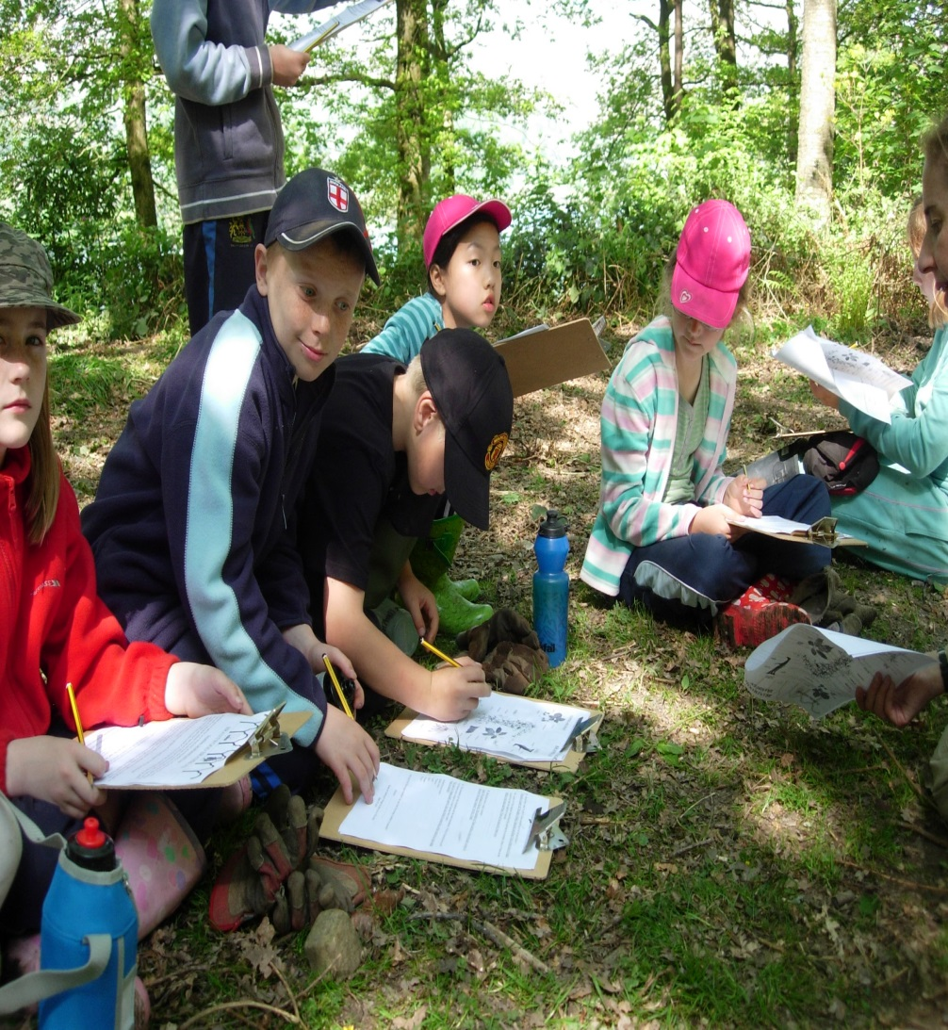
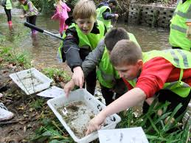
Looking closely

Slide 24
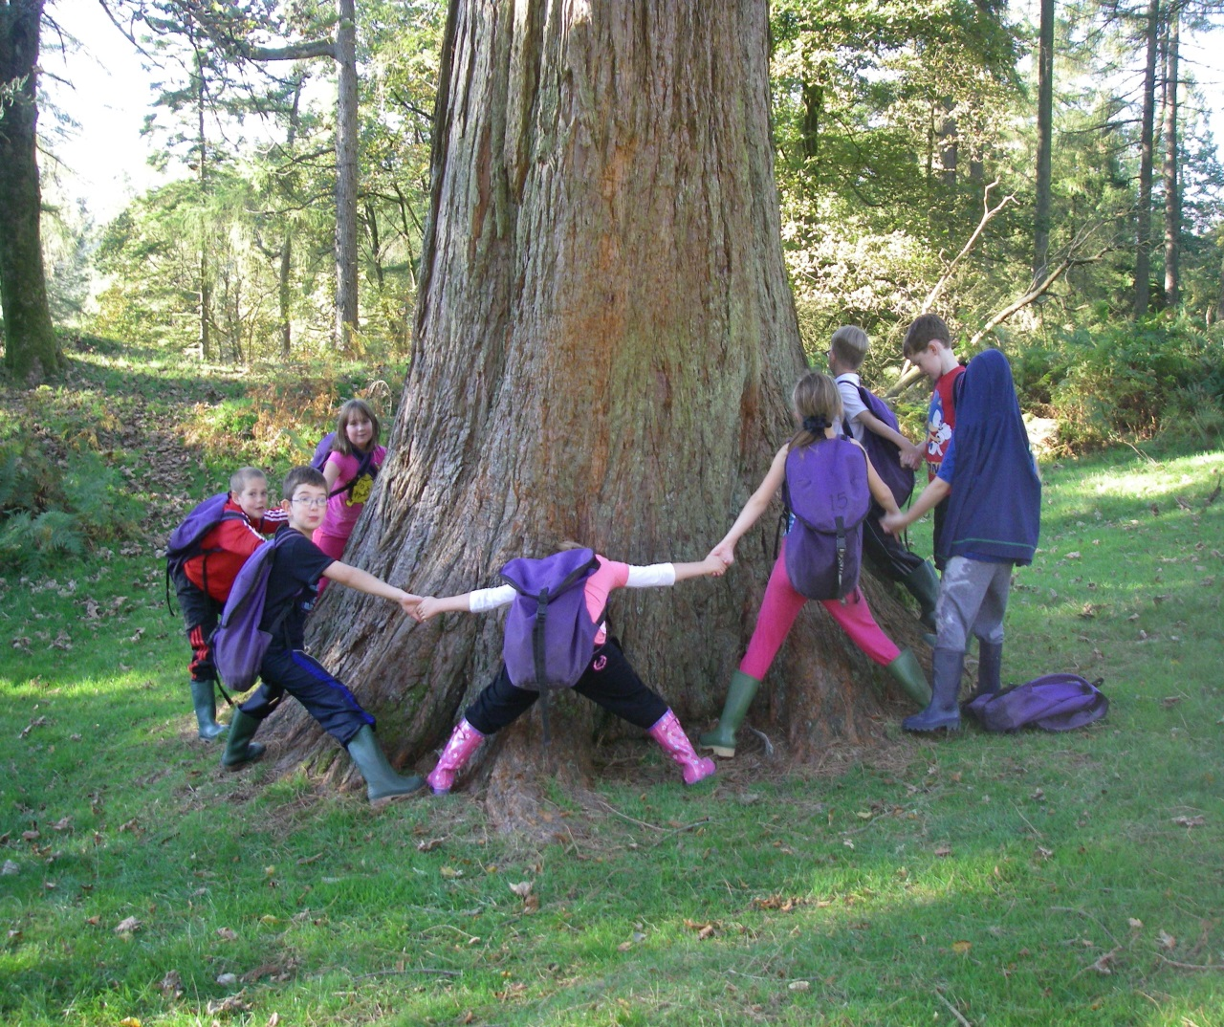
Focus on Environment
Importance of aesthetic approaches
Activities related to place: “in the woods”, “underground”, “on the lake”.
Use of local environment.
Meeting people at work in environment.
Practical conservation

Slide 25
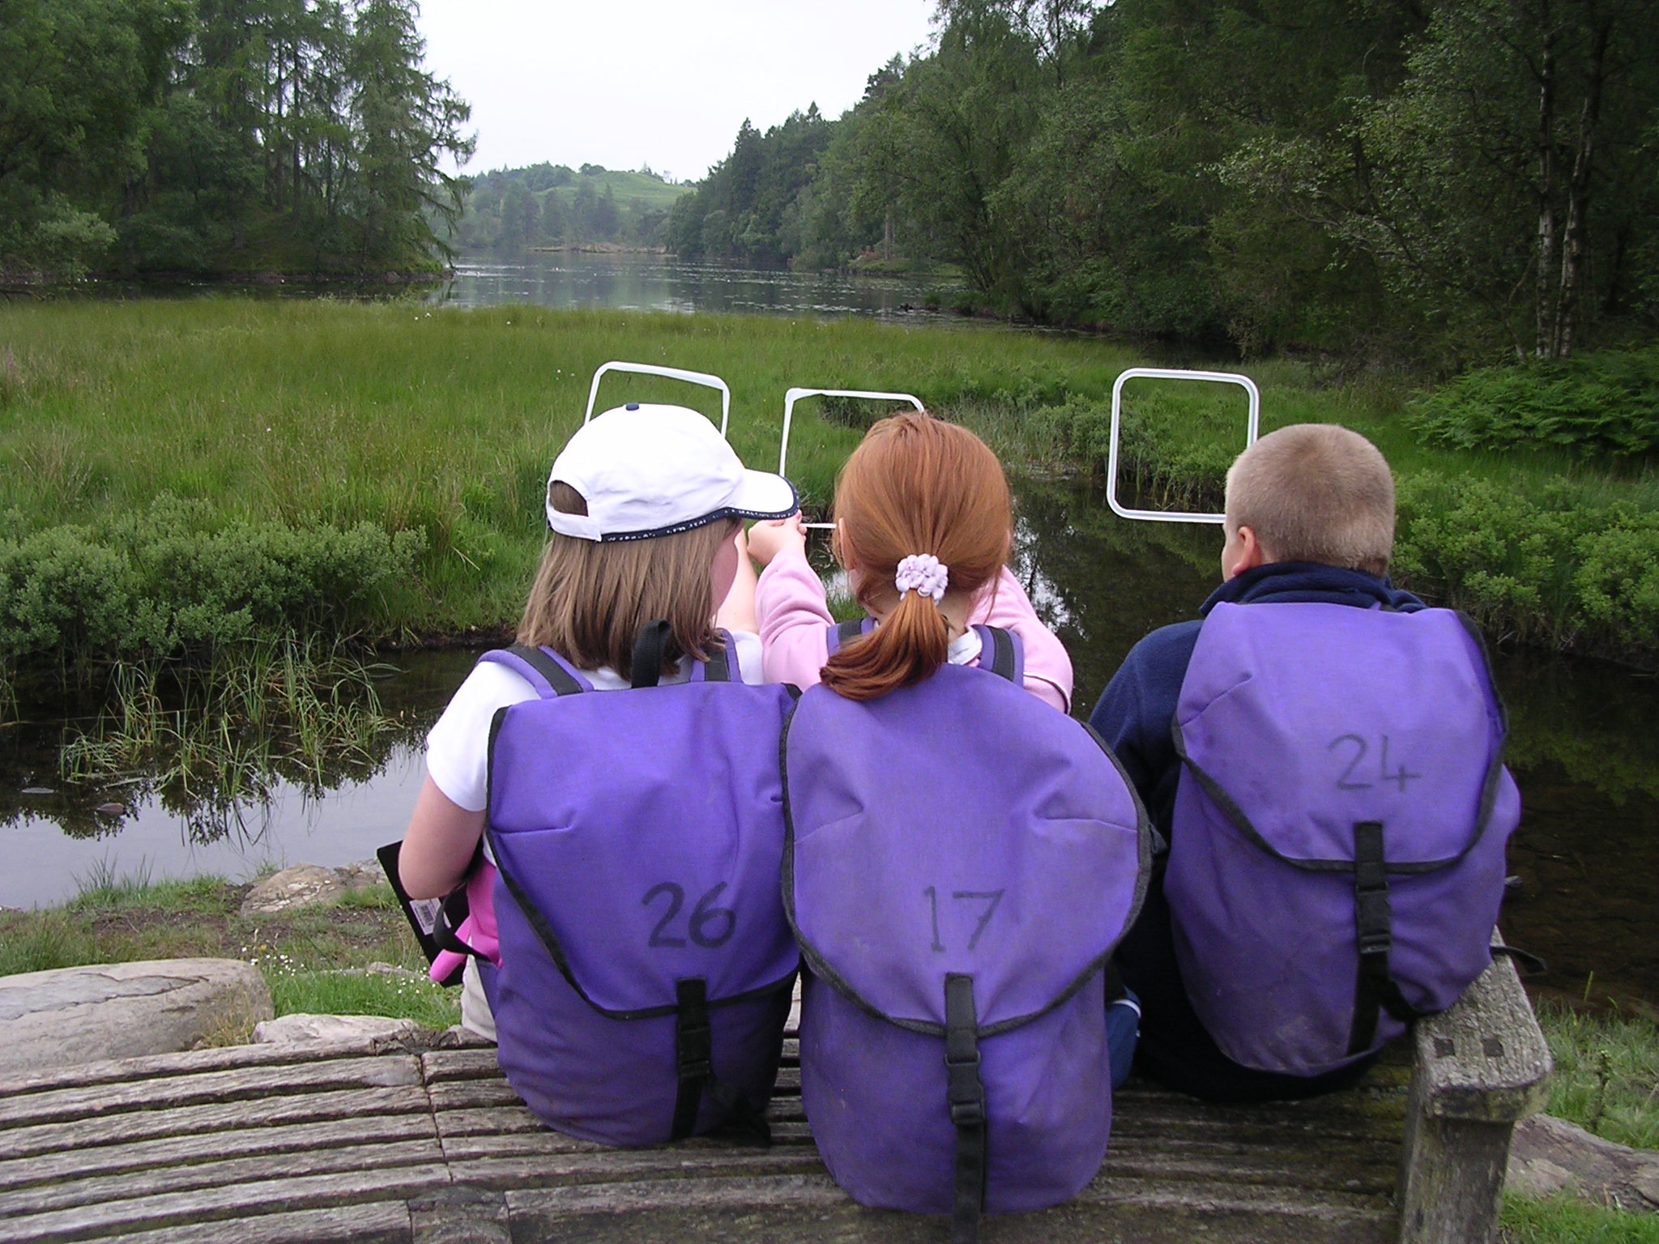

Slide 26
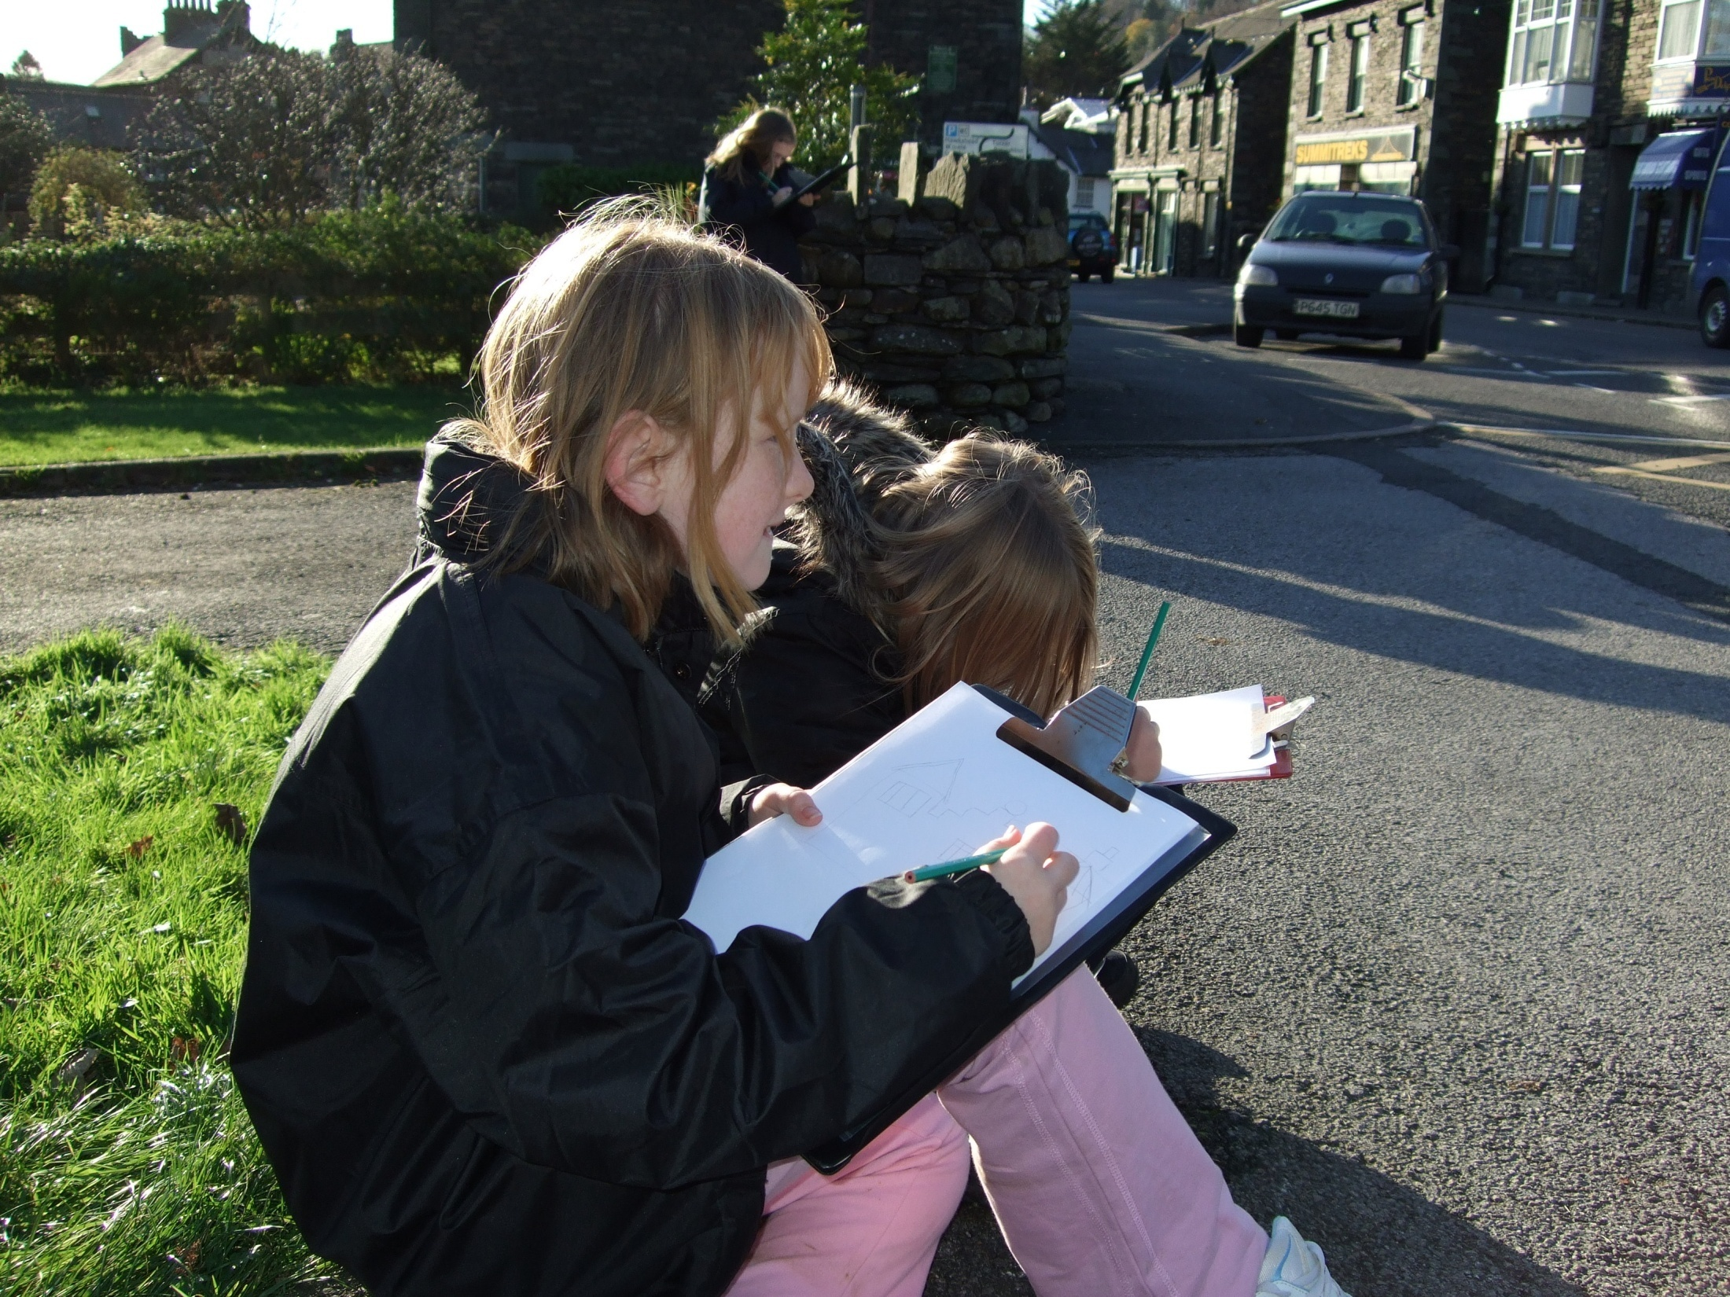

Slide 27
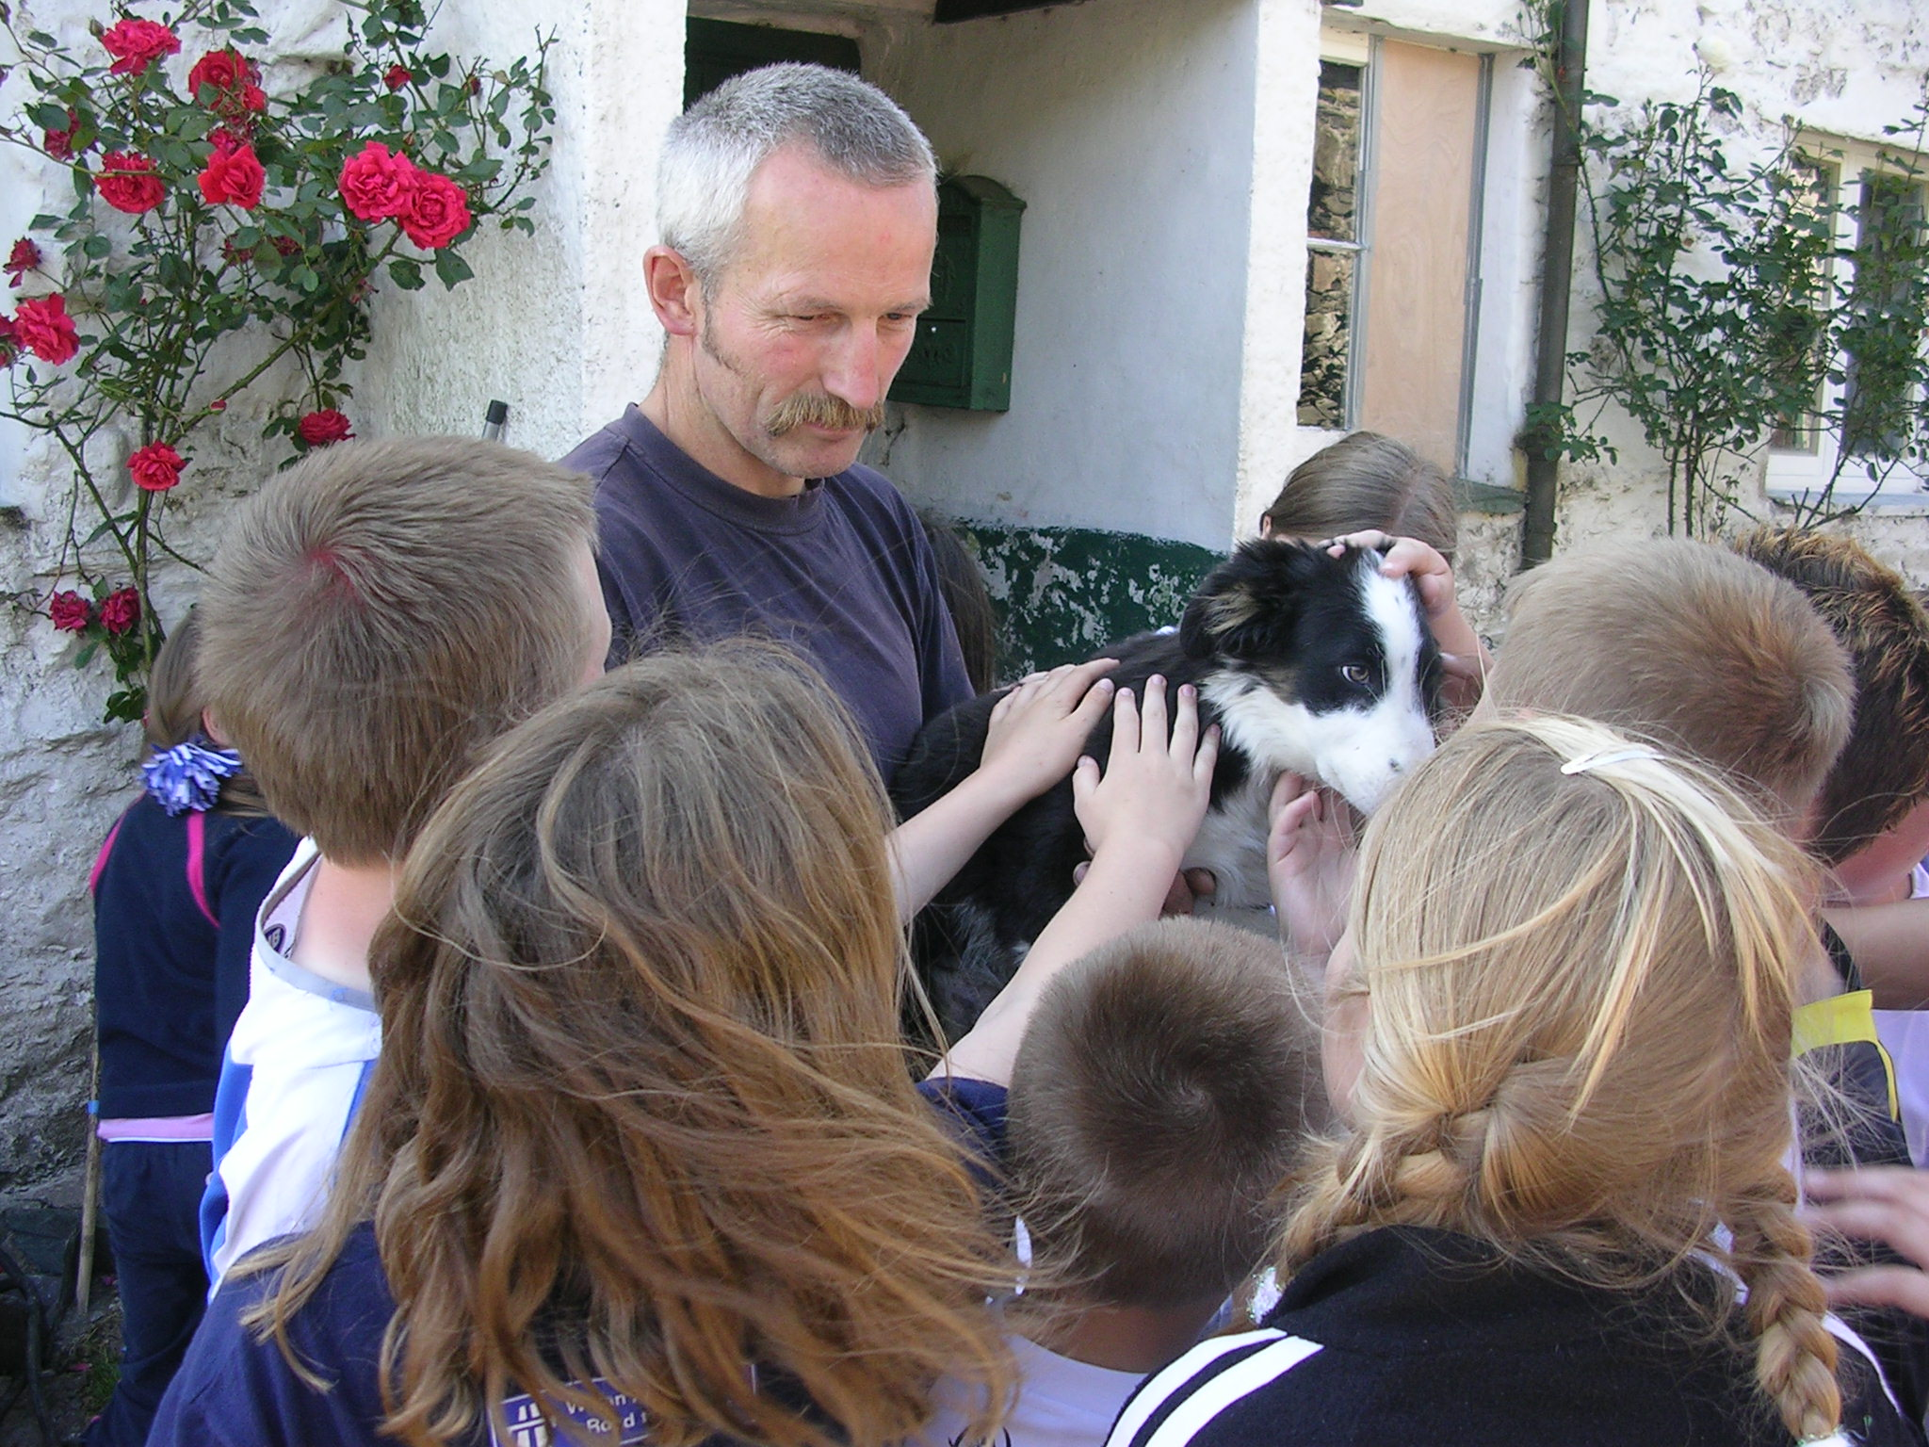

Slide 28
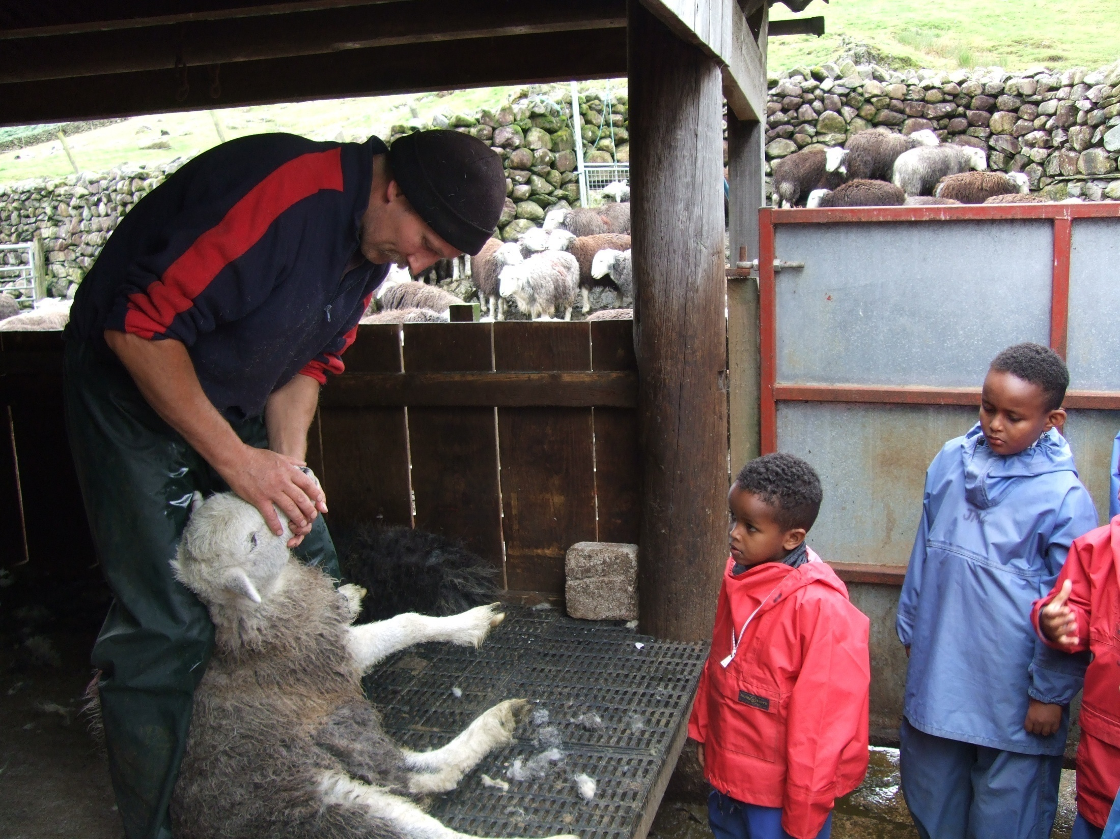

Slide 29
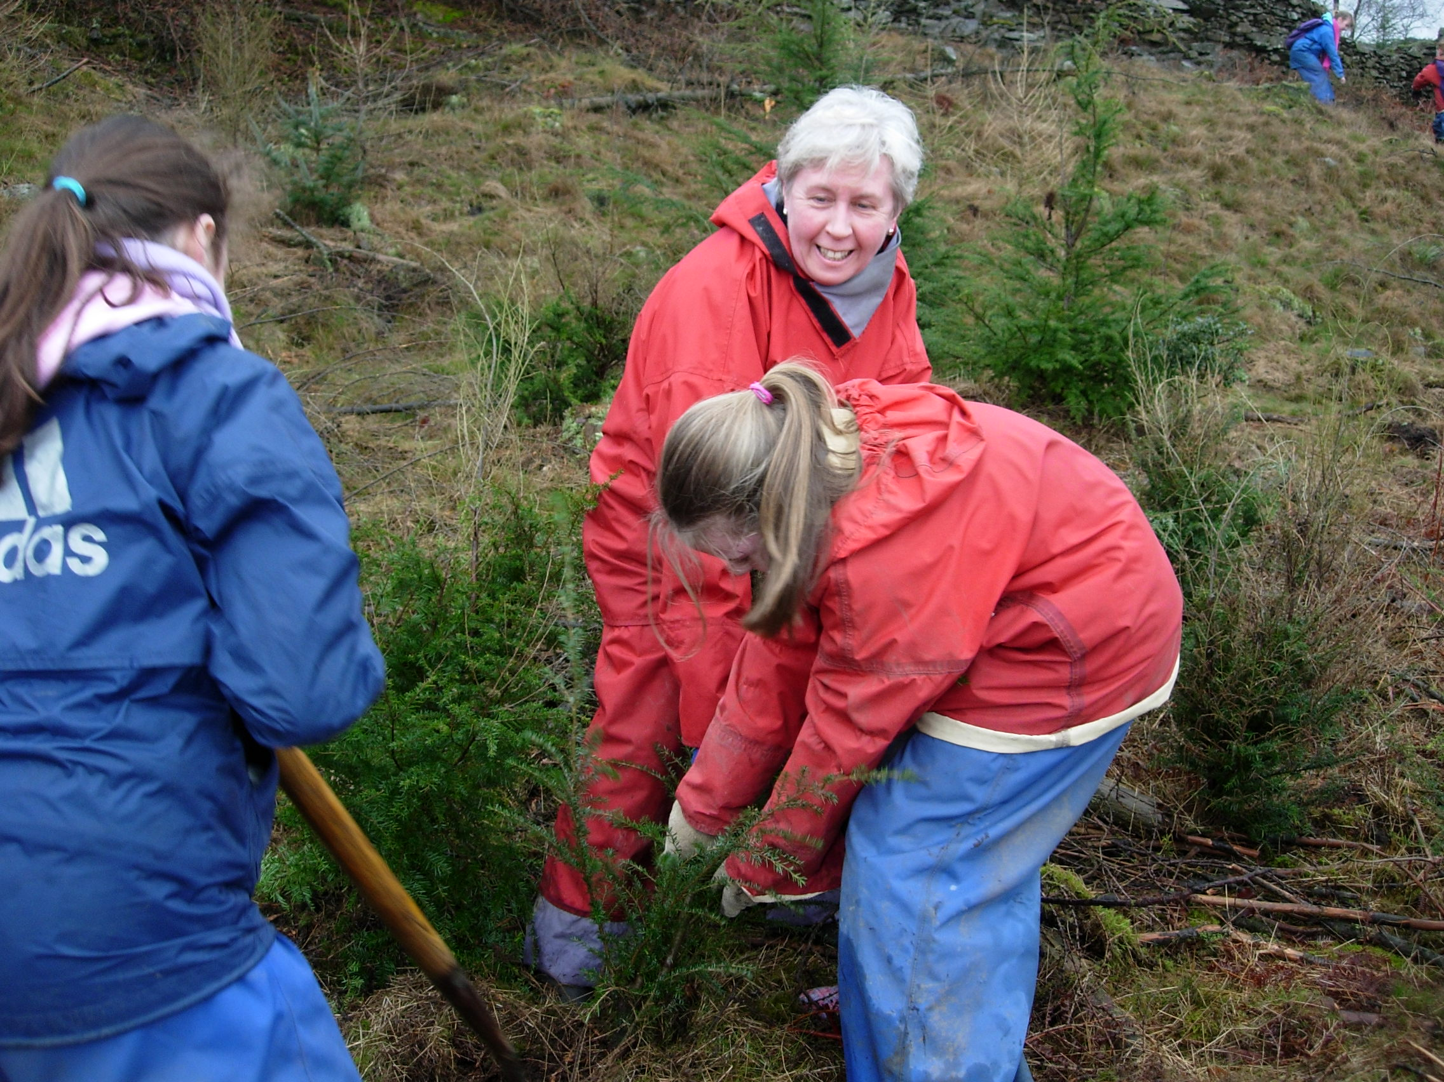

Slide 30
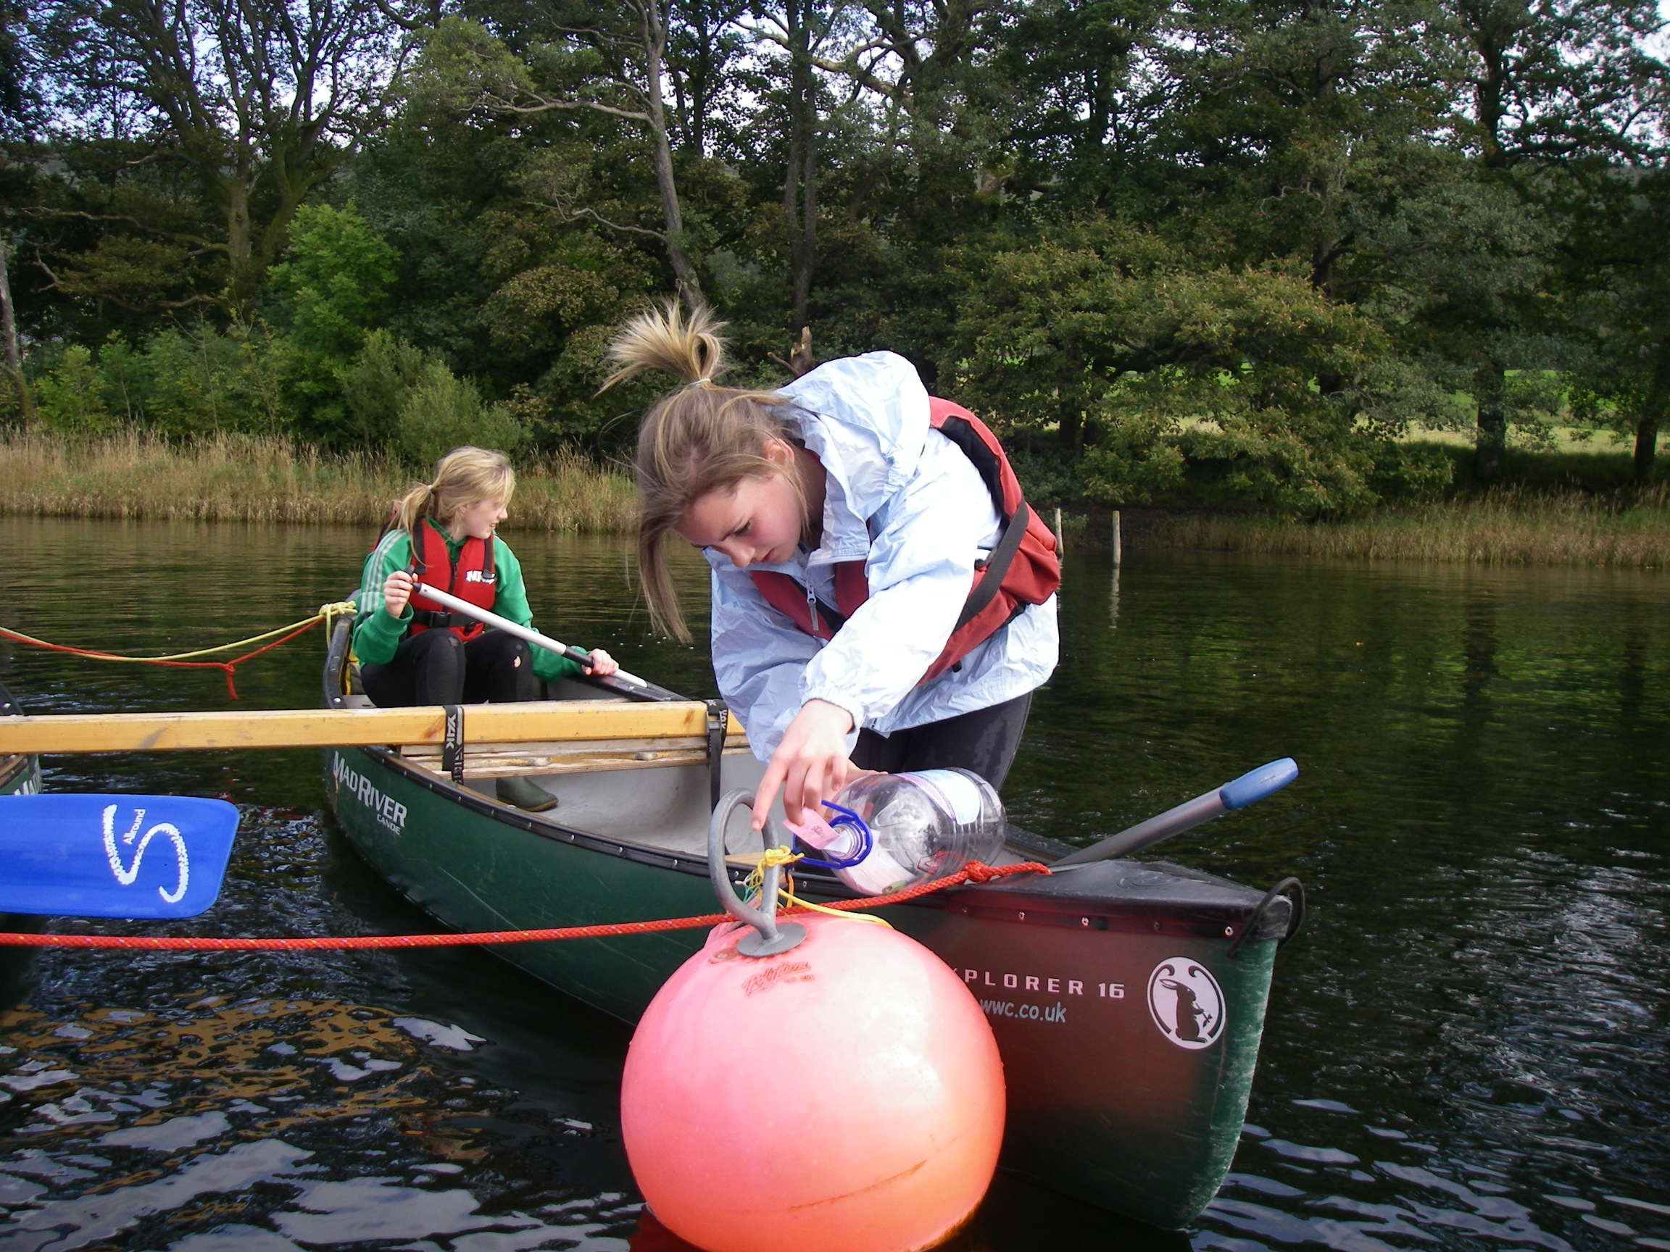
Maths in the outdoors

Slide 31
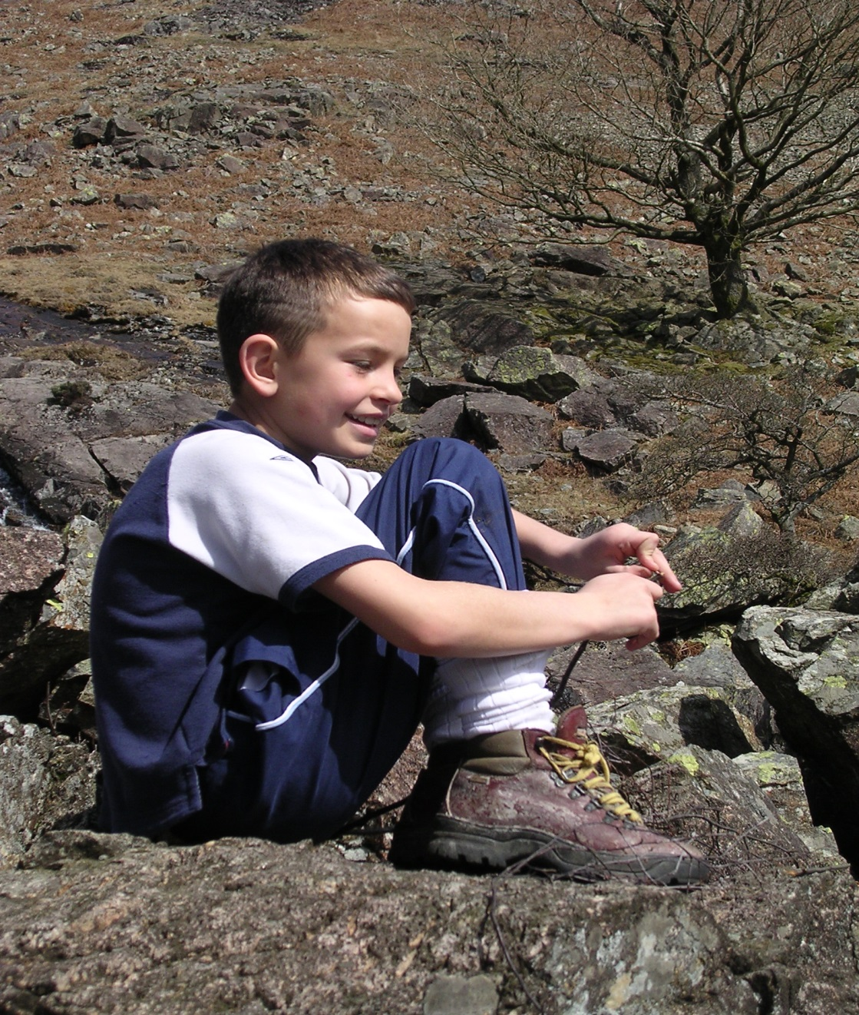
Outdoor experiences and well-being.
Many writers have noted the mental benefits from outdoor activities
They can release tension, offer relaxation, peace of mind and creativity.
Over 100 studies of outdoor experiences in the U.K. state reduction of stress as a benefit.

Slide 32
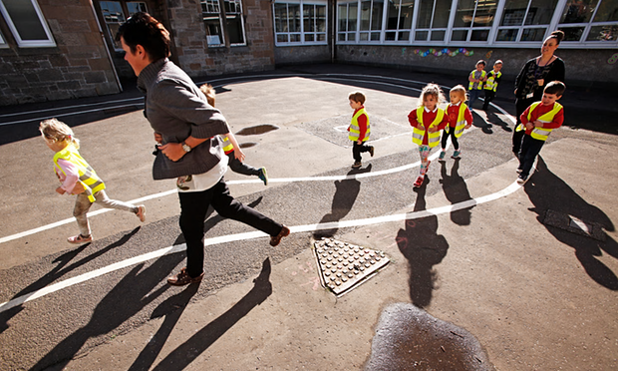
Scottish primary school where pupils run a mile each day.

Slide 33
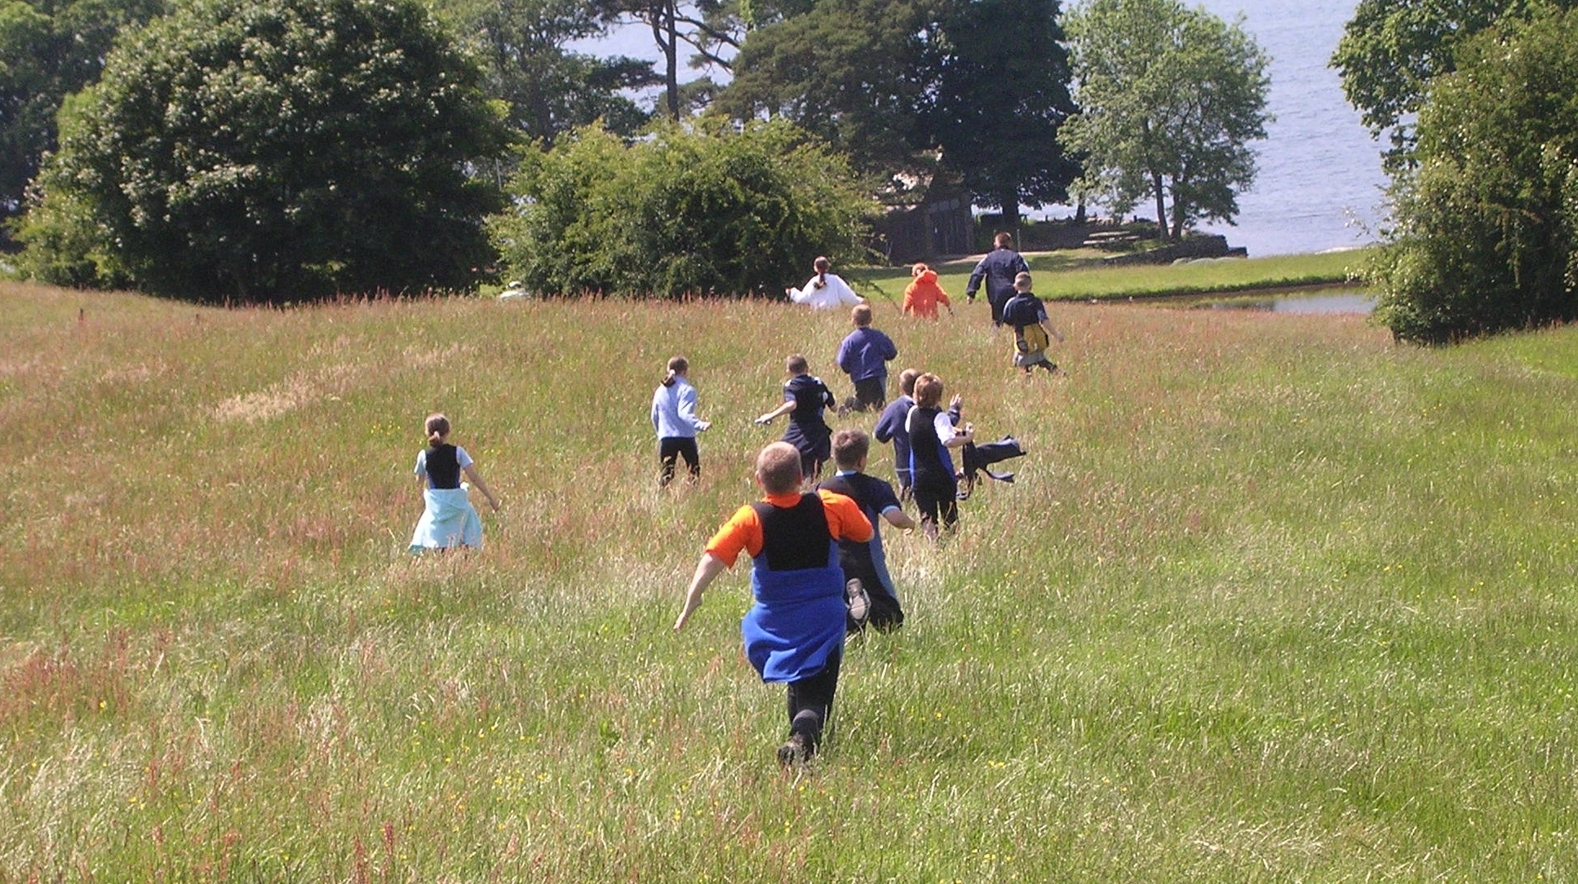
How do we measure this?

Slide 38
Natural Connections project
3 year demonstration project, finishes March 2016.
Funded by DEFRA, Natural England and English Heritage and led by Plymouth Univ.
6 centres across S.W. England
Encourage schools to develop outdoor learning.
Teachers have recorded impact in terms of 4 areas: social skills, engagement, health and attainment.
naturalconnectionsblog.com

Slide 39

www.rwlnetwork.org

